Slide 1
Data Center Infrastructure CT109-3-2&Version 2
Raised Access Floor, connecting the infrastructure with copper and fibre

Slide 2
Topic & Structure of The Lesson
Raised Access Floor, connecting the infrastructure with copper and fibre.

Slide 3
Learning Outcomes
At the end of this module, YOU should be able to:
Understand the debate over whether a raised floor is still needed.
Determine the relevant standards and regulations.
Understand floor loading.
Explain the design considerations with regard to flooring.
Explain where air grille tiles and ramps should be sited and the role played in airflow management and management of the data centre.

Slide 4
Key Terms You Must Be Able To Use
If you have mastered this topic, you should be able to use the following terms correctly in your assignments and exams:
CSMA/CD
IEEE
FC
FC-AL
FC-SW
OM3
OM4
OS1/2

Slide 5
Ethernet IEEE 802.3
IEEE 802 is an IEEE project which started in February 1980, therefore the designation 802. This project concerns itself with standards in the area of local networks (LAN) and establishes network standards for layers 1 and 2 of the OSI model.
However, IEEE 802 teams also give tips for sensibly integrating systems into one overall view (network management, internetworking, ISO interaction).

Slide 6
Ethernet IEEE 802.3
Different teams were formed within the 802 project, and also deal with new project aspects as needed. The oldest study group is the CSMA/CD group IEEE 802.3 for Ethernet. CSMA/CD is a description of the original access method (Carrier Sense Multiple Access with Collision Detection).
The central topic for this study group is the discussion of high-speed protocols. The group is divided up into various other groups which concentrate their effects on optical fibers in the backbone, InterRepeater links, layer management, and other topics.

Slide 7
The most important teams within the IEEE 802.3 study group include:
IEEE 802.3ae with 10 Gbit/s Ethernet, since 2002
IEEE 802.3af with DTE Power via MDI, since 2003 (PoE, Power over Ethernet)
IEEE 802.3an with 10GBase-T, since 2006
IEEE 802.3aq with 10GBase-LRM, since 2006
IEEE 802.3at with DTE Power Enhancements, since 2009 (PoE enhancements)
IEEE 802.3ba with 40 Gbit/s and 100 Gbit/s Ethernet, since 2010
IEEE 802.3bg with 40 Gbit/s serial, in progress

Slide 8
40GBASE-SR4
The IEEE 802.3ba standard for 40GBASE-SR4 or 100GBASE-SR10 makes provisions for, regardless of data rate, maximum lengths of 100 meters for OM3 glass fibers.
The OM4 glass fiber is the preferred choice for longer links (larger data centers, campus backbones, etc.) and applications with lower power budgets (e.g. device connections in data centers). These can support 40GBASE-SR4 and 100GBASE-SR10 applications up to a length of 150 meters.

Slide 9
40GBASE-SR4
The 100-meter link length over OM3 supports – regardless of architecture and size – approximately 85 % of all channels in the data center. The 150-meter link length over OM4 fibers covers almost 100 % of the required range.

Slide 10
Lasers
Lasers used in data centers are usually surface emitting semiconductor lasers, so-called Vertical Cavity Surface Emitting Lasers (VCSEL, pronounced “vixel”). VCSEL are therefore very attractive to networks in data centers because they are easy and cost-effective to produce.
However, they do have a relatively large spectral width for lasers. And exactly the specifications for this spectral width were also relaxed during the transition from 10 to 40/100 GbE.

Slide 11
Lasers
The laser’s maximum permitted spectral width was creased from 0.45 to 0.65nm by IEEE802.3ba,which led to increased chromatic dispersion Chromatic dispersion is the phenomenon of an optical pulse spreading during its transmission through the optical fiber.
A glass fiber has different refractive indices for different wavelengths. That is why some wavelengths spread faster than others. Since a pulse consists of multiple wavelengths, it will inevitably spread out to a certain degree and thus cause a certain dispersion.

Slide 12
Ethernet success criteria
The great success of Ethernet up to the present day can be traced back to the affordability, reliability, ease of use and scalability of the technology. For these reasons, most network traffic these days begins and ends its trip on Ethernet.
Since the computing power of applications grows slower than data traffic as networks are aggregated, the development of 40 and 100 gigabit Ethernet came at just the right time to allow the Ethernet to continue its triumphant march. This is because these high speeds provide that technology

Slide 13
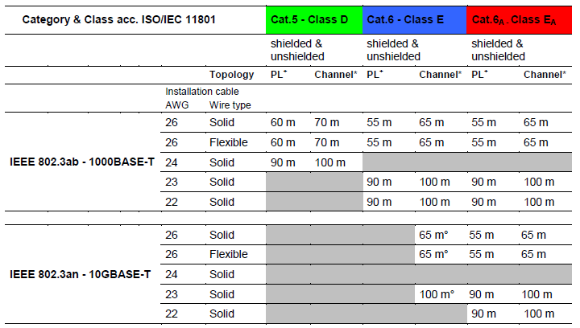
Ethernet Applications for Copper Cables with Cat.5, Cat.6 & Cat.6A

Slide 14
10GBase-T
10GBase-T, 10 gigabit data transmission for copper cables, was standardized in the summer of 2006. It allows for use of a 4-pair cable (transmission on all 4 pairs) and a segment length of 100 m.
There is a “higher speed study group” for 40GBase-T and 100GBase-T, which allows 40 Gbit/s over copper cables, at this point only over 10 m via Twinax cables or 1 m via backplane. However, a 40GBase-T standard is expected, but is rather doubtful for 100Base-T.

Slide 15
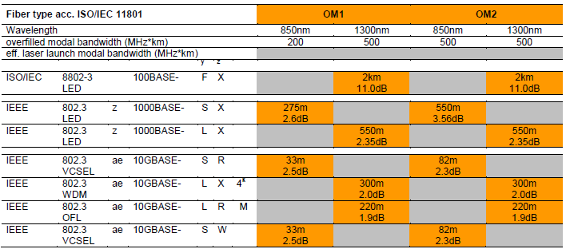
Ethernet Applications for Fiber Optic Cables with OM1 & OM2

Slide 16
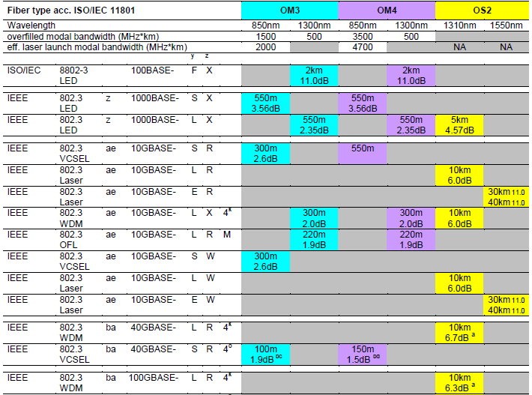
Ethernet Applications for Fiber Optic Cables with OM3, OM4 & OS2

Slide 17
Fibre Channel (FC)
Fibre Channel was designed for the serial, continuous high-speed transmission of large volumes of data. Most storage area networks (SAN) today are based on the implementation of Fibre Channel standards.
The data transmission rates that can be achieved with this technology reach 16 Gbit/s. The most common transmission media are copper cables within storage devices, and fiber optic cables for connecting storage systems to one another.

Slide 18
Fibre Channel (FC)
As in conventional networks (LAN) in which every network interface card has a MAC address, each device in Fibre Channel has a WWNN (World Wide Node Name) as well as a WWPN (World Wide Port Name) for every port in the device. These are 64-bit values that uniquely identify each Fibre Channel device.
Fibre Channel devices can have more than just one port available; in this case the device still has only one WWNN, but it has WWPNs of a number equal to that of the number of ports it possesses. The WWNN and WWPNs are generally very similar.

Slide 19
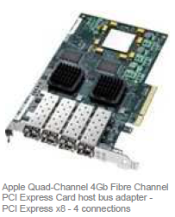

Slide 20
Topologies
In general, there are two different types of Fibre Channel implementations; Switched Fabric, usually known as Fibre Channel or FC-SW for short, and Arbitrated Loop, or FC-AL.
In Fibre Channel Switched Fabric, point-to-point connections are switched between terminal devices, while
Fibre Channel Arbitrated Loop is a logical bus in which all terminal devices share the common data transmission rate.

Slide 21
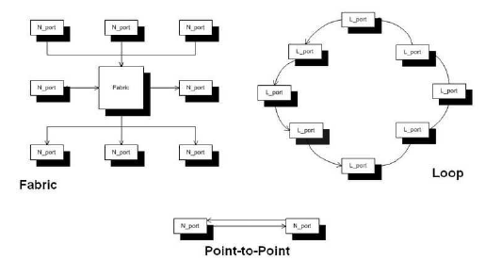

Slide 22
Arbitrated Loop (FC-AL)
Arbitrated Loop (FC-AL) is also known as Low Cost Fibre Channel, since it is a popular choice for entry into the world of Storage Area Networks.
FC-AL implementations are frequently found in small clusters in which it is possible for multiple physical nodes to directly access a common mass storage system. FC-AL makes it possible to operate up to 127 devices on one logical bus.
All devices share the data transmission rate that is available there (133 Mbit/s to 8 Gbit/s, depending upon the technology in use).

Slide 23
Arbitrated Loop (FC-AL)
Cabling is implemented in a star shape over a Fibre Channel hub. However, it is also possible to connect devices one after the other, since many Fibre Channel devices have two inputs or outputs available. Implementing cabling as a ring is not common.

Slide 24
Fibre Channel Switched Fabric (FC-SW)
Fibre Channel Switched Fabric (FC-SW) is the implementation of Fibre Channel which provides the highest performance and greatest degree of failure safety. Switched fabric is generally meant when the term Fibre Channel is used.
The Fibre Channel switch or director is located at the center of the switched fabric. All other devices are connected with one another through this device, so it is possible to switch direct point-to-point connections between any two connected devices via the Fibre Channel switch.

Slide 25
Fibre Channel-based storage advantages
Fibre Channel-based storage solutions offer the following advantages:
Very broad support is provided by hardware and software manufacturers.
At this point, the technology has reached a high level of maturity.
The system is very high-performance.
High-availability solutions can be set up. (redundancy)

Slide 26
Transmission Media
The secret to success of the standards implemented in this area consists of two principles, the specification of cabling components, and the recommendation (not regulation!) for linking these components together in specific topology variants.
A fundamental strength of the favored star-shape topology results from its scalability, since through the use of different materials every layer of the hierarchy can be scaled irrespective of the other layers.
New supplementary standards that are based on this proven star structure were therefore developed for data center cabling systems. They take advantage of this strength and are adapted to these environmental requirements

Slide 27
Twisted Copper Cables (Twisted Pair)
Cabling components based on copper (cables and connecting elements) can therefore be differentiated as follows:
Category 6 (specified up to a bandwidth of 250 MHz)
Category 6A / 6A (specified up to a bandwidth of 500 MHz)
Category 7 (specified up to a bandwidth of 600 MHz)
Category 7A (specified up to a bandwidth of 1,000 MHz)

Slide 28
Twisted Pair standards
With its IEEE 802.3an standard from 2006, the IEEE not only published the transmission protocol for 10 gigabit Ethernet (10GBase-T), but also defined the minimum standards for channels to be able to transmit 10 gigabit up to 100 meters over twisted copper lines.
EIA/TIA followed with its 568B.2-10 standard in 2008 which set higher minimum standards for channels, and also specified requirements for components: Category 6A was born.

Slide 29
Twisted Pair standards
In the same year, the ISO/IEC 11801 published Appendix 1, which formulated even stricter requirements for channels: channel class EA was defined. The definition of components remained open.
This gap was closed in 2010 with publication of ISO/IEC 11801, Appendix 2. This new standard defines components, i.e. Category 6A cables and plug connections – note the subscript A – in the process setting standards which surpass those of EIA/TIA.

Slide 30
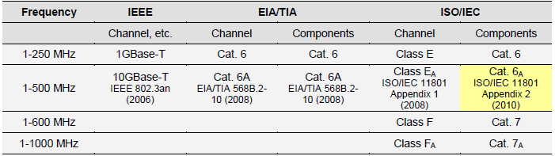
Current cabling standards for typical data center requirements

Slide 31
Cable Selection
It is generally known that maximum bandwidth usually also allows a maximum data rate. If cable prices are equal in terms of length, preference should be given to the cable type of the highest quality (i.e. Category 7A), unless this results in clear drawbacks, such as a large outer diameter. This is because this cable category is theoretically more difficult to install and leads to larger cable routing systems, both of which can increase costs

Slide 32
Pre-Assembled Systems / Plug-and-Play Solutions
Trunk cables consisting of multiple twisted-pair cables or multi-fiber cables, both ends terminated with normal plug connectors or jacks or even a special unique manufacturer-specific connector. Manufacturers also provide a measurement report for all connections, especially for glass fiber systems.
Modular terminal blocks which can be mounted in the cabinet using 19” technology or even in special double floor systems. Trunk cables can be connected to this block at the input side using the special connector, and then completely normal RJ45 jacks or even glass fiber couplers are available on the output side.

Slide 33
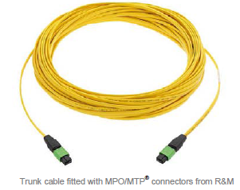
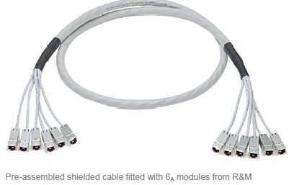

Slide 34
Plug Connectors for Twisted Copper Cables
The RJ45 connection system has been being developed over decades, from a simple telephone plug to a high performance data connector.
The RJ45 plug and jack interface was defined by ISO/IEC JTC1/SC25/WG3 as the international ISO/IEC 11801 standard, and is considered a component in universal cabling systems. It is used as an eight-pole miniature plug system in connection with shielded and unshielded twisted copper cables.

Slide 35
Plug Connectors for Twisted Copper Cables
The RJ45 is the most widely distributed of all data connectors, and is used in both the area for connecting terminal devices like PCs, printers, switches, routers, etc. – in the outlets and on connection/patch cables – as well as in distribution frames for laying out and distributing horizontal cabling.

Slide 36
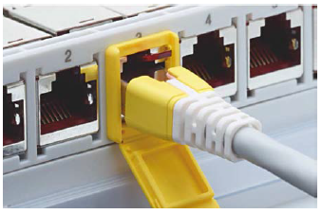

Slide 37
Selecting Connection Technology
As compared to the “cable question” the “connector question” is more difficult to solve, if one consistently chooses to use cabling of class F or class FA, which, however, is not required for 10GBase-T .
This is because the only choice that remains when opting for Category 7 or 7A connection systems is between the TERATM connection system and the GG45- and ARJ45 connector types.

Slide 38
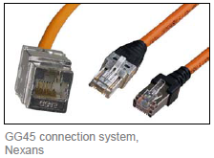
GG45 jack
The advantage of the GG45 jack lies in its compatibility with existing RJ45 connection cables, since all previous cables can be re-used, up to the first use of a link for Class F(A).
However, tenders in which Category 6A/A technology and GG45-based technology were compared show that the use of GG45 leads to about triple the price in overall connection technology (mind you: a factor of 3 for materials and assembly!) and this in turn is what turns off many clients.

Slide 39
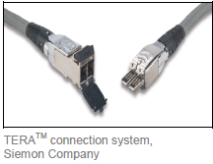
TERA connection system
The additional cost of the TERA connection system is not so high, but on the other hand this system forces an immediate use of new connection and patching cables (TERA on RJ45). As in the case of GG45, many clients accept this restriction only reluctantly.

Slide 40
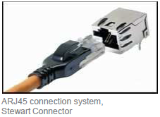
ARJ45
ARJ45 (augmented RJ) likewise satisfies Category 7A standards and thus those of link class FA. Furthermore, ARJ45 connection systems can be used in addition to 10 gigabit Ethernet in other high-speed networks like InfiniBand or Fibre Channel (FC), or to replace Serial Attached SCSI (SAS) or PCI-Express (PCIe). ARJ45 is interoperable with the GG45 plug connector, which has the same areas of application. Even its form factor is identical to that of the RJ45 connector.

Slide 41
Glass Fiber Cables (Fiber optic)
Glass fiber is a fascinating medium. It promises bandwidth that is virtually without limits. However, it is also a delicate, brittle medium. It takes a skilled person to handle glass fiber cabling.
Nevertheless, by using proper planning and well-thought-out product selection, data centers can get a successful and problem-free start into their glass fiber future.
The continuously growing requirements of data centers leave no other choice. Nowadays, data centers must include glass fibers in their planning to enable them to cope with migrating the data center to 40/100 gigabit Ethernet, growing data volume and many other requirements beyond that.

Slide 42
Glass Fiber Cables (Fiber optic)
Scalability, performance, access time, security, flexibility, and so on can be optimized through the use of glass fibers. Advances in glass fiber technology,

Slide 43
Multimode, OM3/4
Optical fibers can be differentiated between glass optical media (Glass Optical Fiber, GOF) and plastic (Plastic Optical Fiber, POF). Due to its clearly lower performance capabilities, POF is not suitable for data center applications.
Three types of glass fibers:
Multimode glass fibers with step index profile
Multimode glass fibers with gradient index profile
Single mode glass fibers

Slide 44
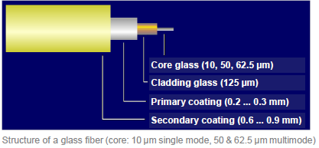

Slide 45
OM3 and OM4
OM3 and OM4 are laser-optimized 50/125 μm multimode glass fibers. While OM1 and OM2 fibers are used with LEDs as signal sources, lasers are used for Category OM3 and OM4 fibers. In general, these are type VCSEL lasers (Vertical-Cavity Surface-Emitting Laser), that are considerably more cost-effective than Fabry-Perot lasers, for example. Lasers have the advantage that, unlike LEDs, they are not limited to a maximum frequency of 622 Mbit/s and can therefore transmit higher data rates.

Slide 46
Single mode, OS1/2
In contrast to multimode glass fibers, only one light path exists for single-mode glass fibers due to its extremely thin core, typically a diameter of 9 μm. Since it is therefore impossible for multi-path propagation with signal delay differences between different modes to occur, extremely high transmission rates can be achieved over great distances.
Also known as mono-mode fibers, single mode fibers can be used in the wavelength range from 1,280 to 1,650 nm, in the second or third optical window. This results in a theoretical bandwidth of 53 THz.

Slide 47
Single mode, OS1/2
On the other hand, single-mode glass fibers place maximum demands on light injection and connection technology. They therefore come into use primarily in high-performance areas like MAN and WAN backbones.

Slide 48
Quick Review Question
Discuss Fiber Channel.
Compare FC-AL with FC-SW.
Briefly Explain OM3 and OM4.

Slide 49
Summary of Main Teaching Points
Discussed Raised Access Floor, connecting the infrastructure with copper and fibre.

Slide 50
Question and Answer Session
Q & A

Slide 51
What we will cover next
IT Hardware

